Slide 1
2015 OOP Assignment
20122457 이호준
20142332 김형근

Slide 2
Index
Structure
ScreenShot
Playing Dance program

Slide 3
Structure
Tester
(main)
dancingrobots
“interface”
RobotParts
JComponent
RobotViewer
Robot
Background
SoundThread
Thread
JFrame

Slide 4
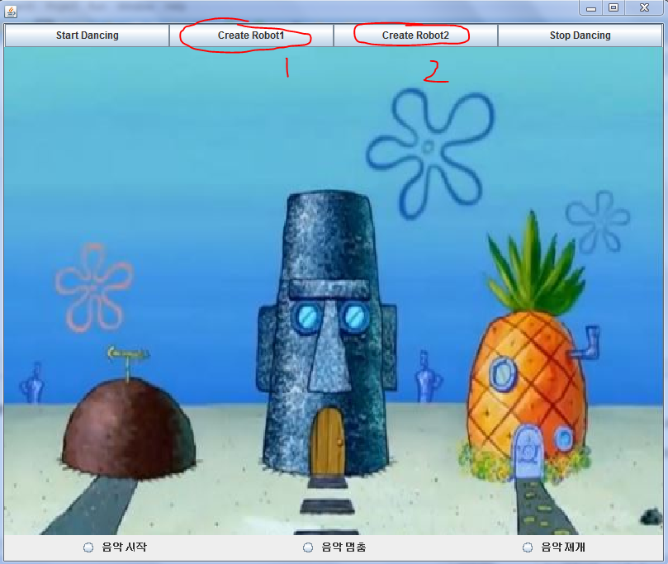
ScreenShot

Slide 5
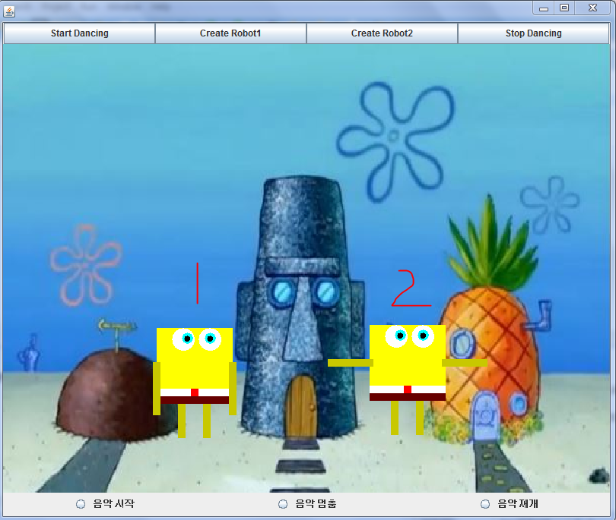
ScreenShot

Slide 6
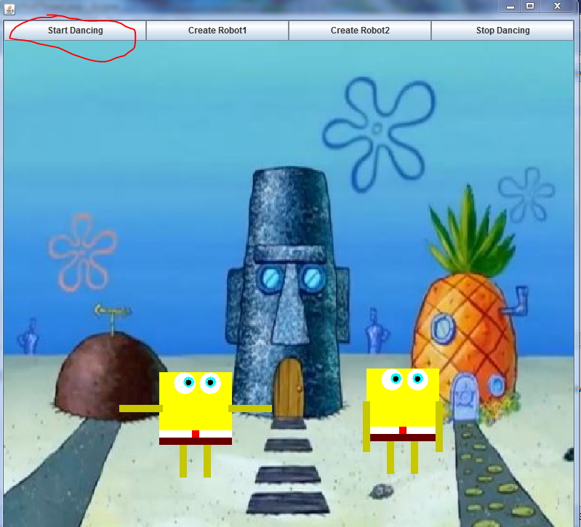

Slide 7
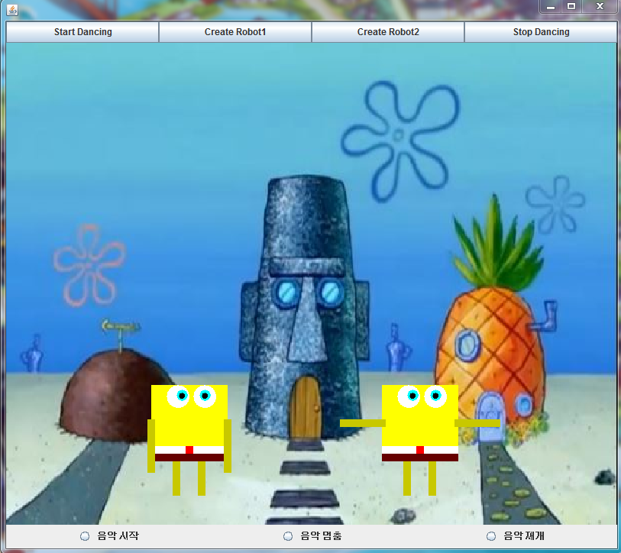

Slide 8
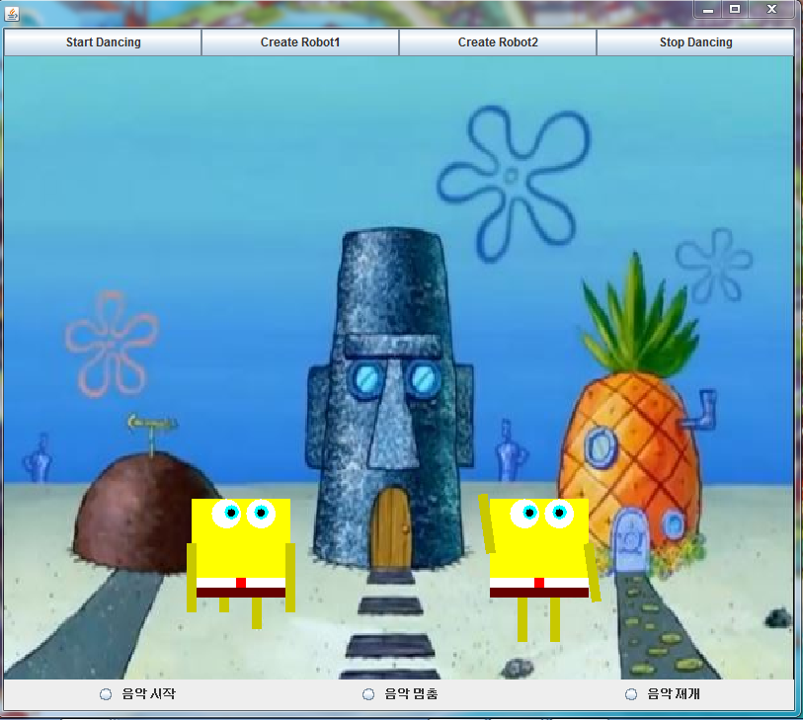

Slide 9
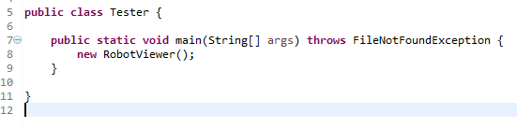
It’s too simple…..

Slide 10
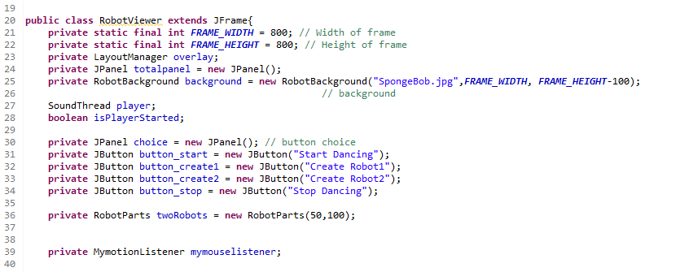
This is quite many Fields in RobotViewer…

Slide 11
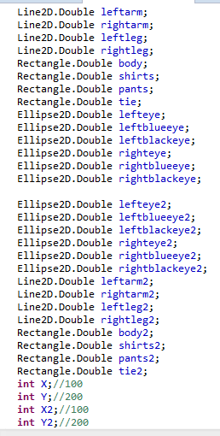
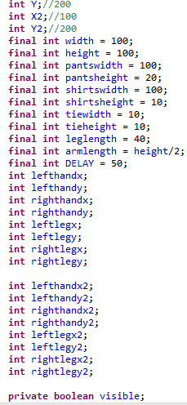
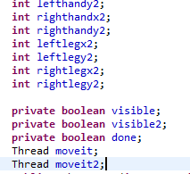
Soooo Many Fields in RobotParts

Slide 12
Let’s Introduce more detail of Robot-Viewer.
Mymotion-
listener
totalpanel
RobotViewer
RobotParts
Robot
Background
SoundThread

Slide 13
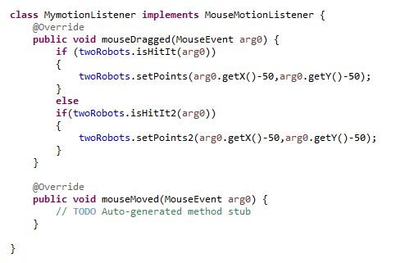
Mymotionlistener

Slide 14
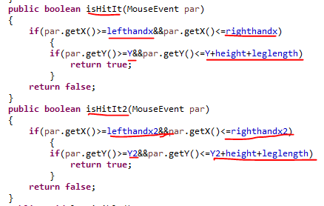
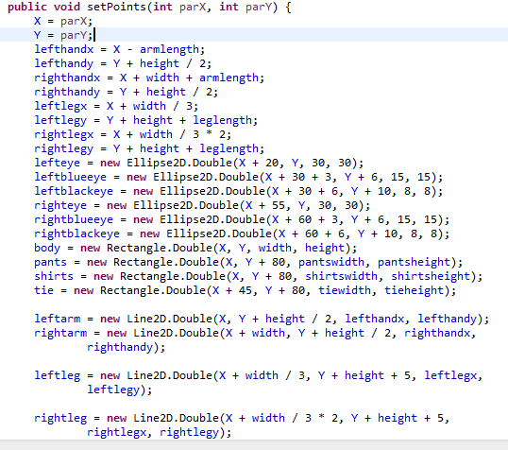
isHitIt(), setPoints() from RobotParts

Slide 15


totalpanel
Adding must be sequential.

Slide 16
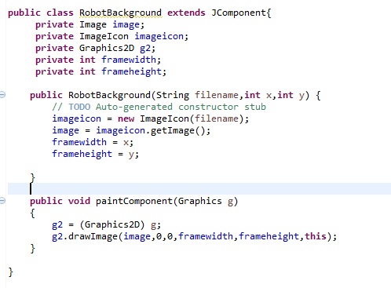
RobotBackground()

Slide 17
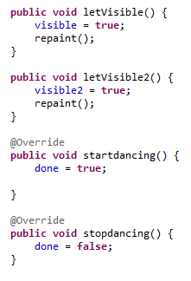




Robotparts()

Slide 18
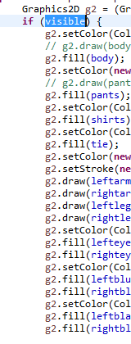
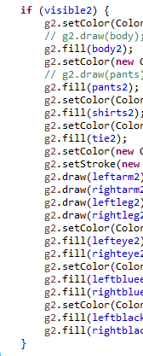
letvisible()’s visible working:
From paint paint-Component
(Graphics g)
of Robotparts()

Slide 19
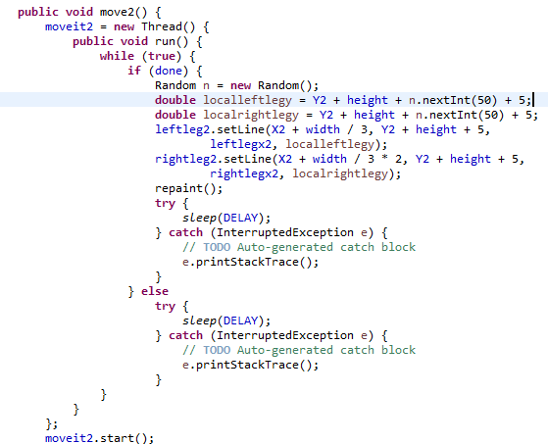
startdancing’s done working
It’s used to changing location in infinite loop!

Slide 20
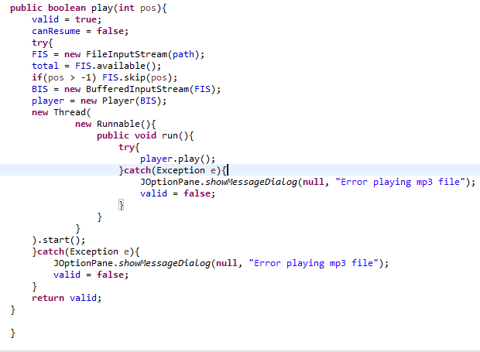
SoundThread()

Slide 21
Thank you

